Slide 1
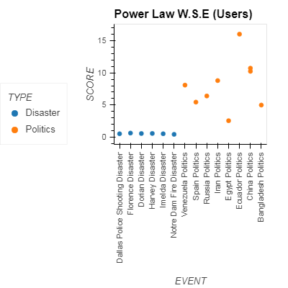
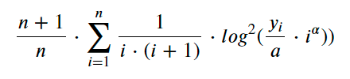
A score chart for each dataset.
The score is based on the weighted
Distance of each data point from a fitted line.

Slide 2
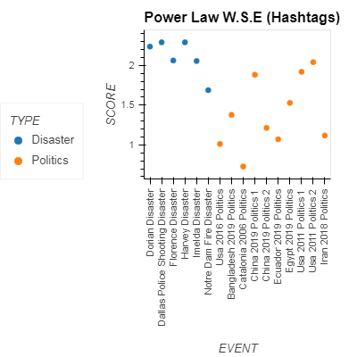
A score chart for each dataset.
The score is based on the weighted
Distance of each data point from a fitted line.

Slide 3
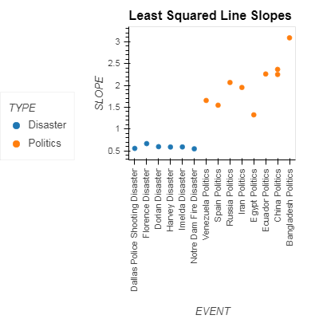
A score chart for each dataset.
The score is based on the slope of a fitted line to a data set distribution.

Slide 4
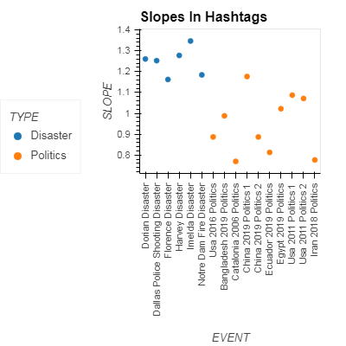
A score chart for each dataset.
The score is based on the slope of a fitted line to a data set distribution.

